Slide 1


Congratulations on your Achievement Award!
Please use the instructions below on how to personalize and present your recognition video.
Add your facility name and picture on slide 4.
Add your outpatient award seal/s to slide 10.
Delete this page.
File > Export > Make sure your presentation settings are "Full HD” and “Use Recorded Timings and Narrations” > Create Video.
Present!

Slide 2



The American Heart Association’s Outpace CVD™ suite offers technology solutions and quality improvement support for healthcare organizations participating in our programs as they target cardiovascular disease.
We support and recognize your organization’s commitment to improving patient outcomes.
Heart.org/OutpaceCVD
Notes:
OP CVD is a suite of QI resources, data tool, and support services to improve hypertension, diabetes, and cholesterol control connecting national initiatives like TBP, TT2D, and CCC.
Target: BP in partnership with the AMA
TT2D in partnership with ADA
CCC…

Slide 3

Patient outcomes improve when medical professionals follow the most up-to-date evidence-based treatment guidelines.

Slide 4
[Healthcare Organization Name] is
committed to promoting consistent adherence to the latest scientific treatments.
[Insert image from your healthcare organization / facility.]

Slide 5

Over 2,700 healthcare organizations participate in the American Heart Association’s
Outpatient Quality Improvement programs,
an ongoing effort to bring evidence-based care to reduce cardiovascular deaths, heart attacks and strokes.

Slide 6
Being honored for giving excellent patient care is the greatest form of recognition a healthcare organization can get.

Slide 7

That’s why we’ve made a commitment...

Slide 8

To turn treatment guidelines into lifelines…

Slide 9
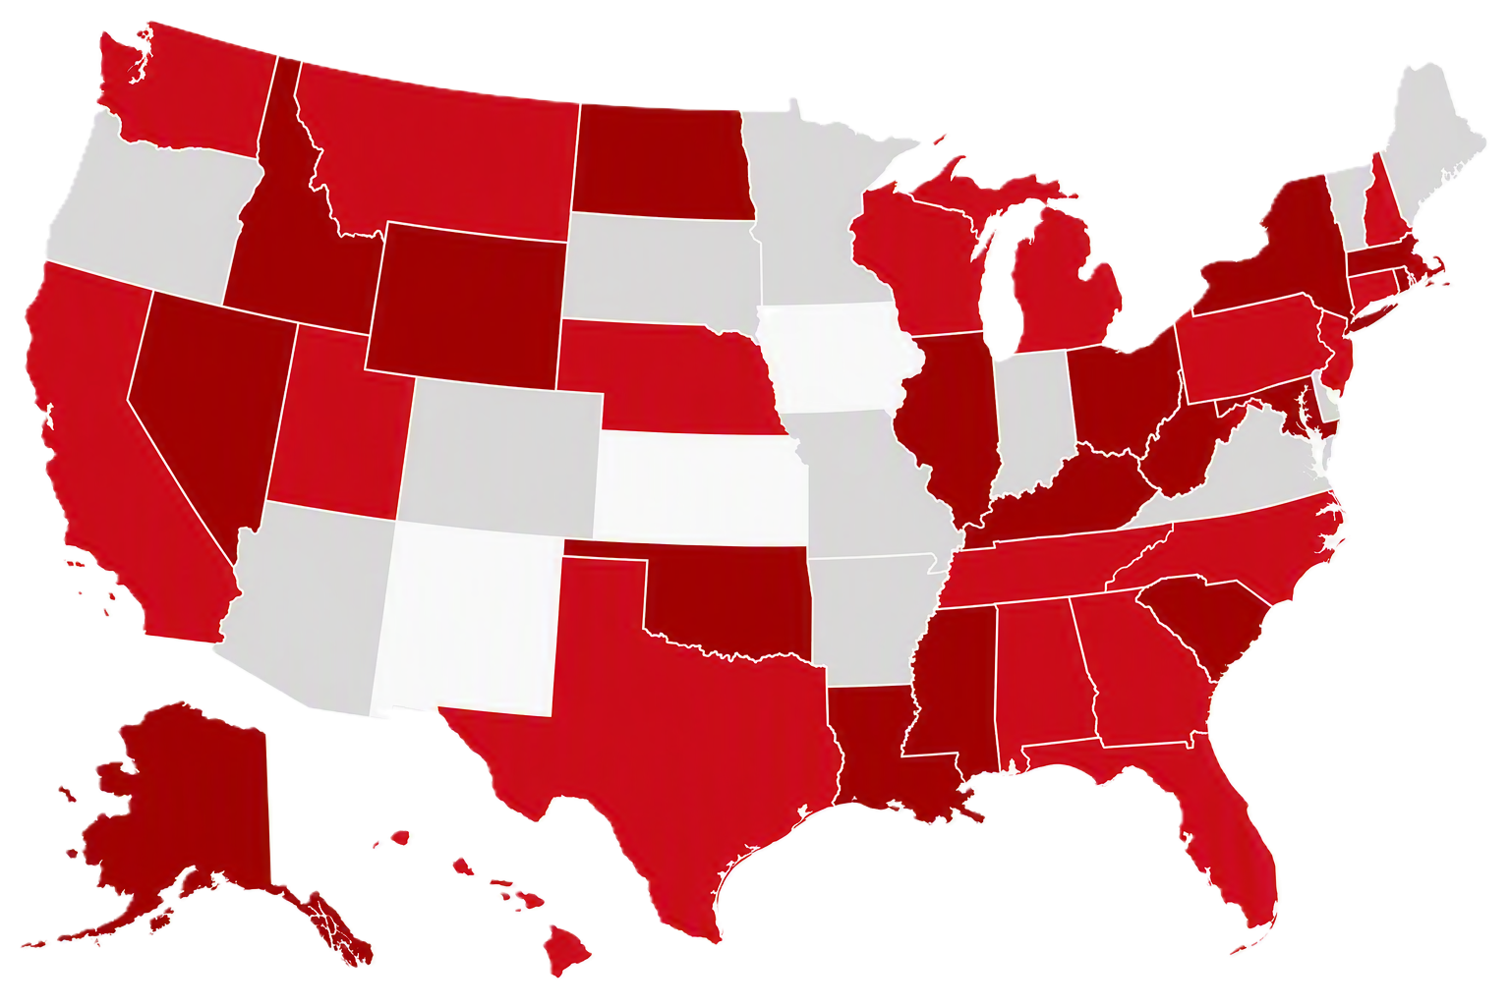
improving the lives of all patients.

Slide 10

Thank you for your outstanding performance treating patients with the latest in evidence-based care.
[Add your award icon from Check. Check. Control. Cholesterol, Target: BP and/or Target: Type 2 Diabetes then delete this text and the appropriate award icon placeholder image(s)]

Slide 11
For more information, visit
www.heart.org/OutpaceCVD

